Slide 1

Making the Shift Left –
Bringing Ops to Dev
before bringing applications to production

Slide 2



Making the Shift Left Bringing Ops to Dev before bringing applications to production
Development
DevOps
Operations
Application
Platform
DigitalXchange – 3rd June 2023
Lucas Jellema, CTO & Architect Conclusion

Slide 3
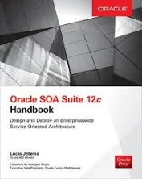
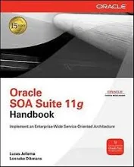

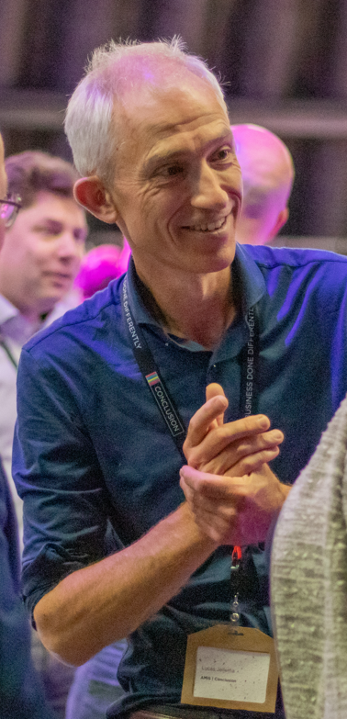
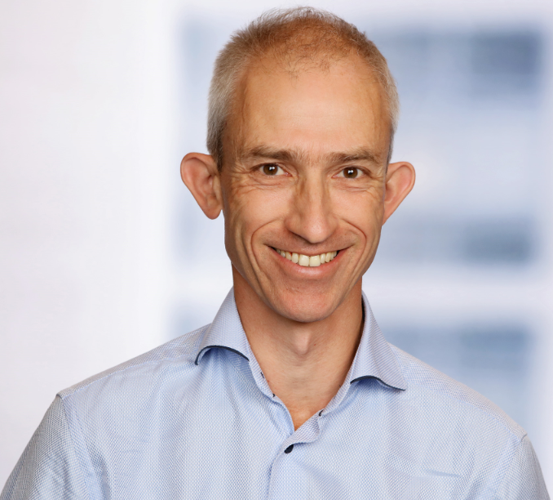


Architect on many integration initiatives with dozens of large and small organizations in The Netherlands
Oracle ACE Director, Java Rockstar, author of two books on integration
frequent speaker on conferences & active blogger
Lucas Jellema
Cloud Solution Architect & CTO
lucas.jellema@conclusion.nl | technology.amis.nl | @lucasjellema | lucas-jellema

Slide 4

25 years

Slide 5

Light Bulb moment

Slide 6
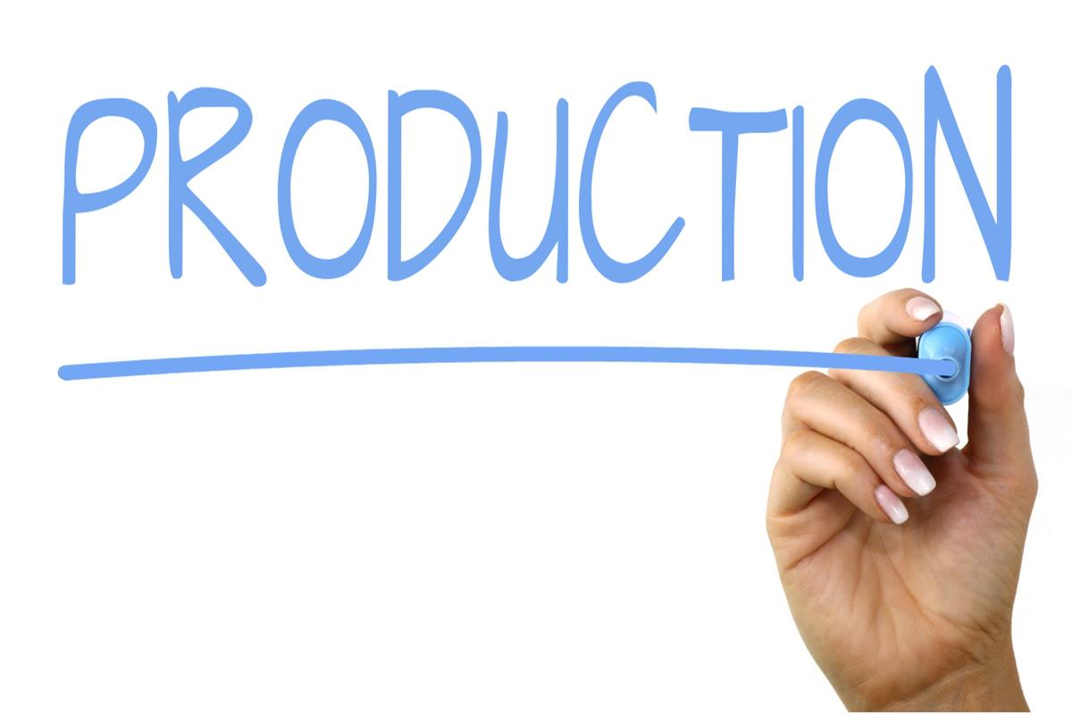
Production!

Slide 7

business process
Application
Application
Application
Platform
Platform
Platform
Platform
Infrastructure
Infrastructure
Infrastructure
Infrastructure
Infrastructure

Slide 8
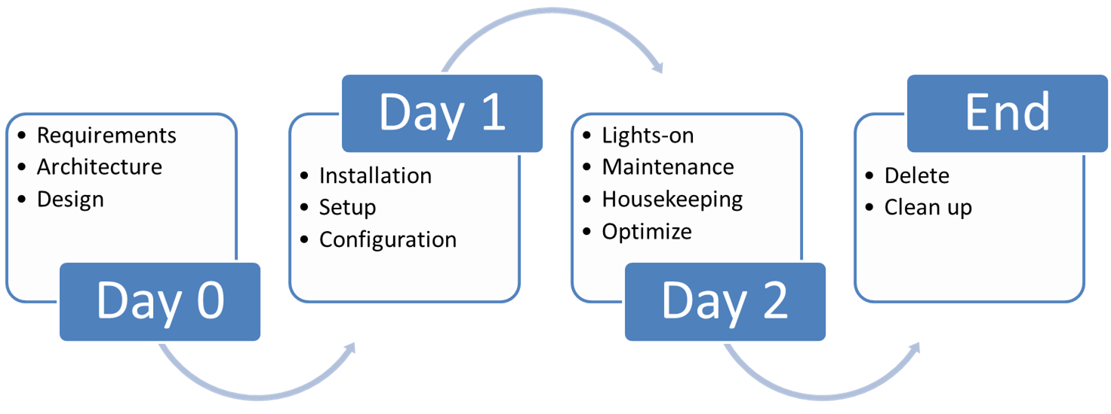
business process
Application
Application
Application
Platform
Platform
Platform
Platform
Development
Infrastructure
Infrastructure
Infrastructure
Infrastructure
Infrastructure
Operations

Slide 9
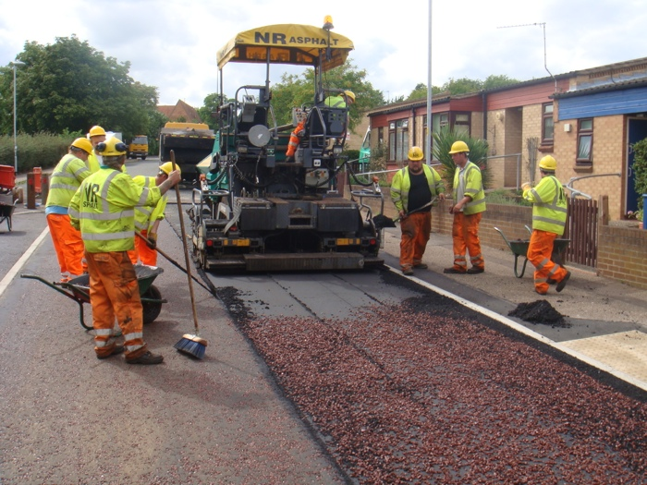

Development
Operations

Slide 10
Development
You Build It, You Run It
you make it run after you have built it
you keep it running
You Fix It
You Evolve It
Operations

Slide 11

Development
You Build It, You Run It
you make it run after you have built it
you keep it running
You Fix It
You Evolve It
Operations

Slide 12
Development
You Build It, You Run It
you make it run after you have built it
you keep it running
You Fix It
You Evolve It
Operations

Slide 13
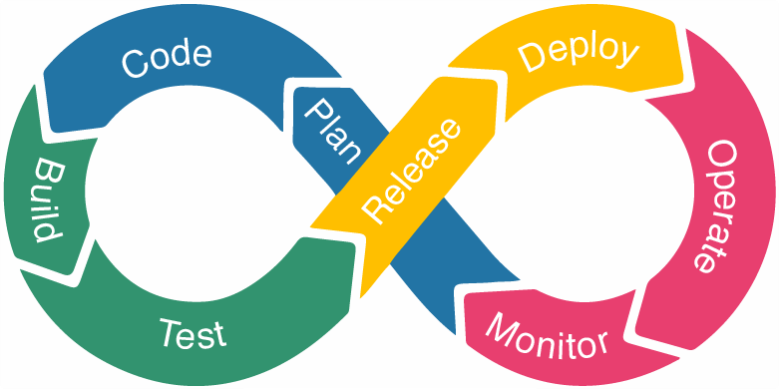
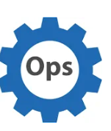
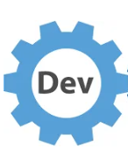
DevOps Cycle
https://medium.com/t%C3%BCrk-telekom-bulut-teknolojileri/devops-lifecycle-continuous-integration-and-development-e7851a9c059d
Notes:
https://medium.com/t%C3%BCrk-telekom-bulut-teknolojileri/devops-lifecycle-continuous-integration-and-development-e7851a9c059d

Slide 14
Shift Left – Operations & Development without hand-over
DevOps
Application Development
Platform & Infra Operations

Slide 15
Shift Left – Operations and Development without hand-over
DevOps
Application Development
Application Operations
Platform & Infra Development
Platform & Infra Operations

Slide 16
Shift Left – Operations and Development without hand-over
Development
Operations
DevOps
Application
Platform & Infra

Slide 17
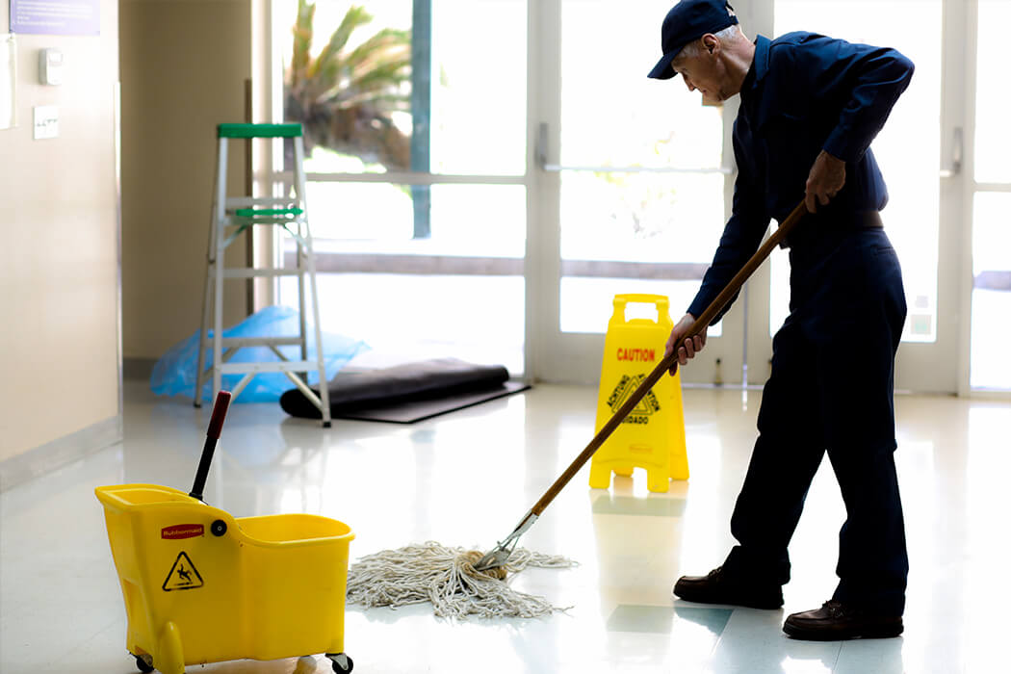
What is Ops?
Make Up, Make Perform (as needed)
Handle Exceptions
Ensure Safe & Secure
Watch | Control | Reduce Costs
Optimize for Sustainable/Green run
Grease the wheels & Clean the floors
clean, prune, small technical maintenance, odd little jobs
(prepare for) Disaster Recovery
Report on Day to Day operations

Slide 18



Objectives & Constraints for Operations
Service Level Agreement (contract)
Business Requirements
Principles, Guidelines, Rules, Constraints
architecture,
security,
regulatory
Professional responsibility, ethical

Slide 19

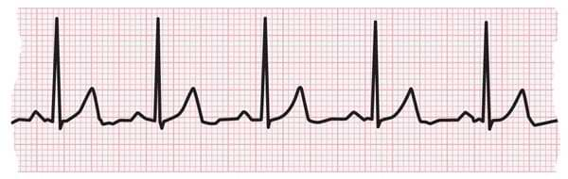
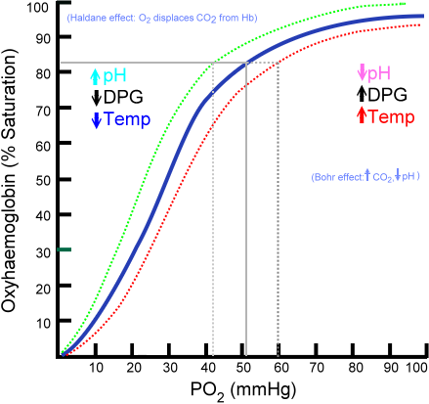
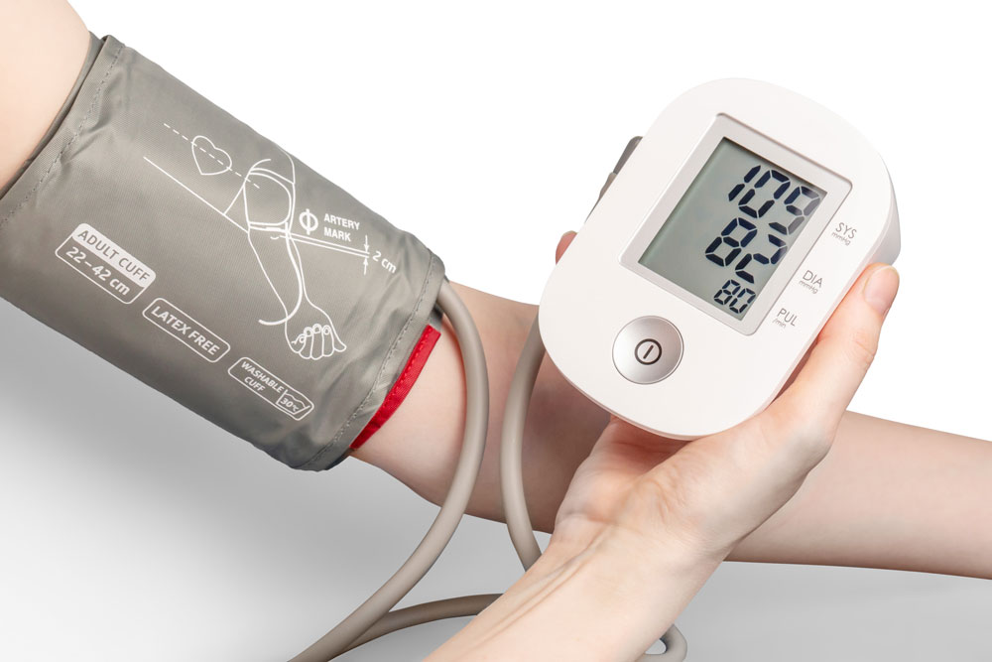
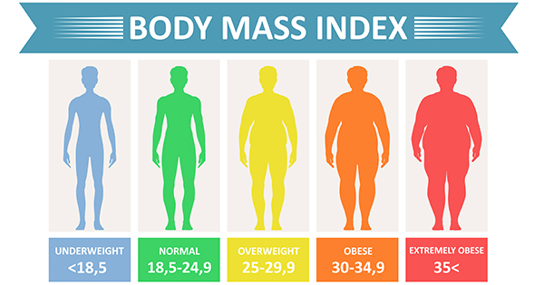
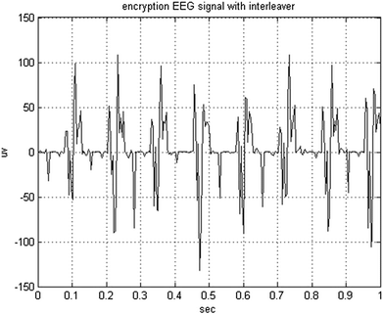

What to Measure and what to Aim for?

Slide 20
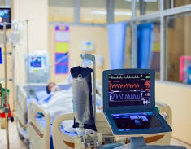
What level of care?
Application + Platform + Infra need to allow for the required level of care
observe status (& trend ⬄)
compare with goals
work within constraints
decide act upon action
have protocols to follow and instruments to take action
This requires early preparation

Slide 21


Notes:
angry suppliers
their bills have not been paid. Why Not?
They have been approved (in the invoice management app) - but not forwarded to the financial system where payment is done

Slide 22

daily approved invoices batch
record, approve/deny
invoices
€
Basware
MS Business Central - Finance
€
€
integration
€

Slide 23



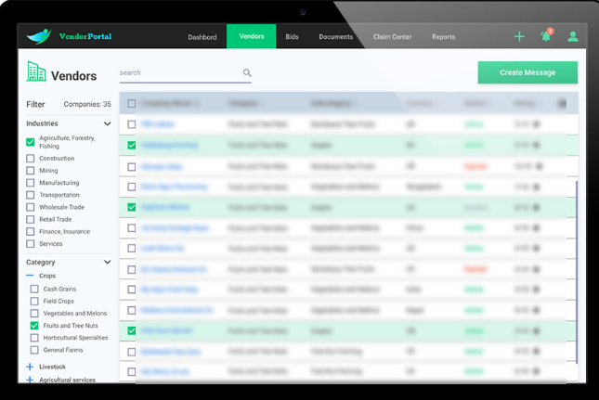
Notes:
the web portal was never the fastest application in the world but usually performed at a stable if barely acceptable level
several times during the month its performance collapsed and it became unusable. 20-30 seconds wait times and time outs.
it was unclear why that happened – at those specific moments

Slide 24

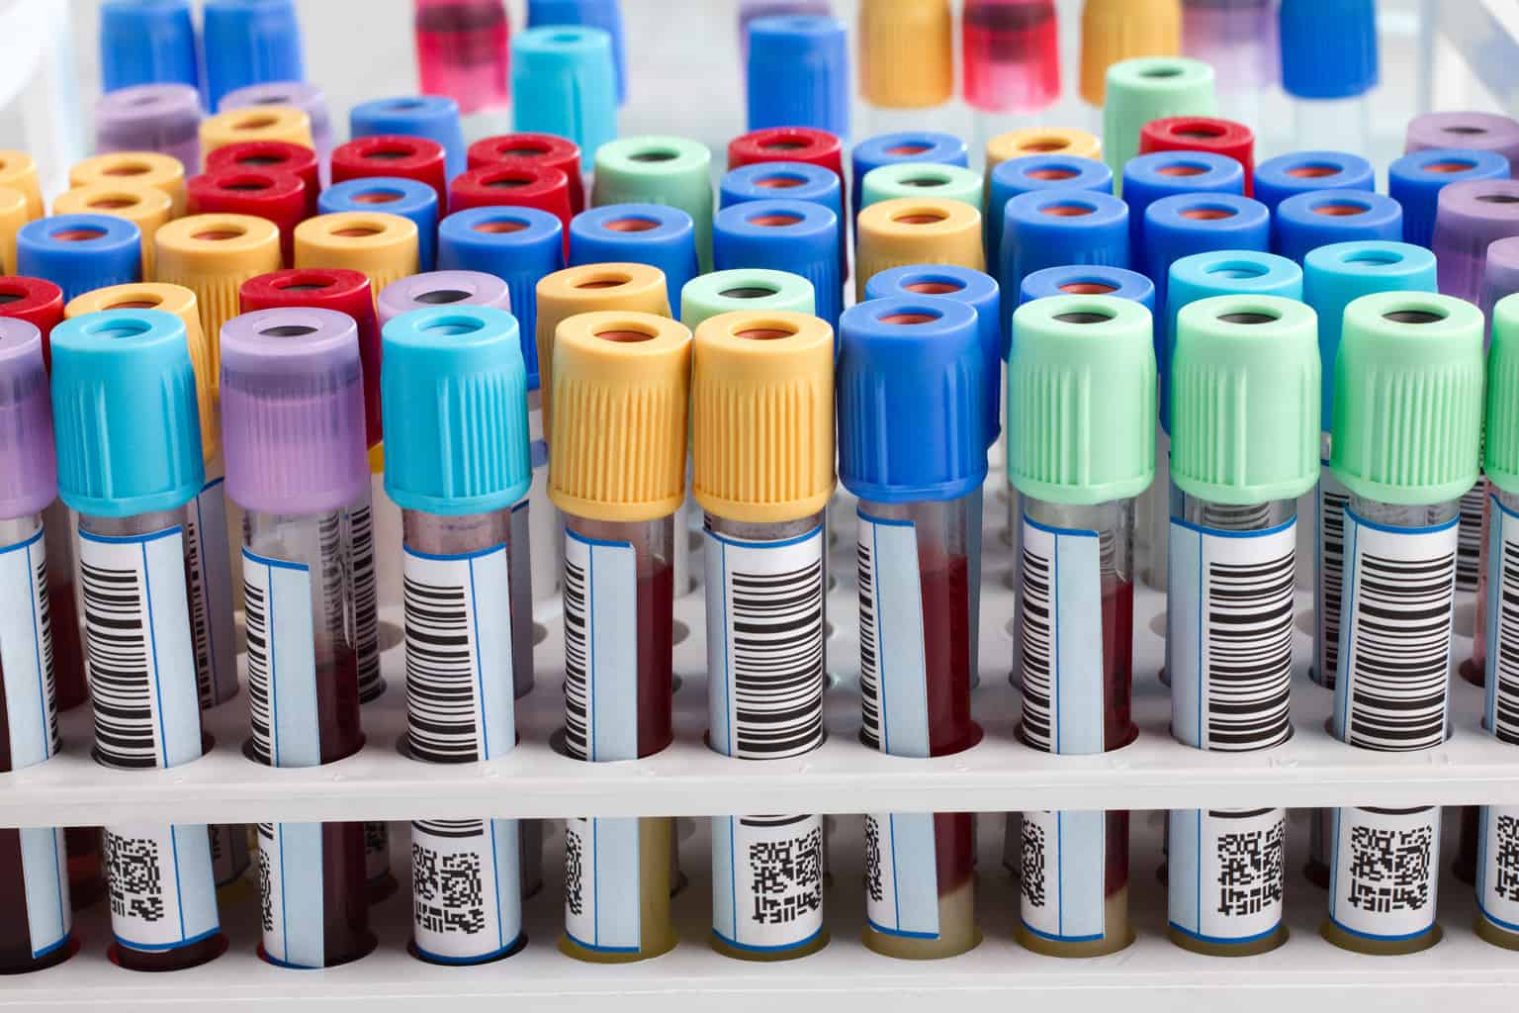


lab results
Web Portal
Service Bus
Enterprise Database

Slide 25
Common thread
Requirements
Development
Build, Test, Q&A
Release & Deploy

Slide 26
Common thread
Requirements
Operations
Development
Build, Test, Q&A
Release & Deploy

Slide 27
Shift Left
Requirements
Operations
Development
Build, Test, Q&A
Release & Deploy
Ops by Design

Slide 28
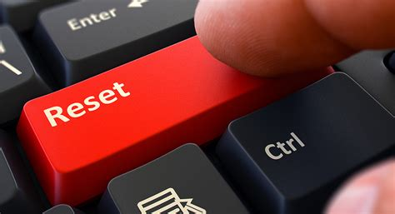
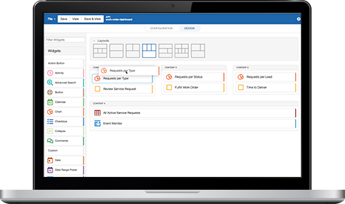

Required for successful operations
Definition of what is success
What are non-functional constraints and conditions?
Security, availability, performance, costs, CO2
KPIs and targets?
Whenever the monitoring indicated that a service was down – the entire portal was stopped and restarted
One particularly unstable service determined whether today was the user’s birthday. It triggered multiple restarts per day …

Slide 29
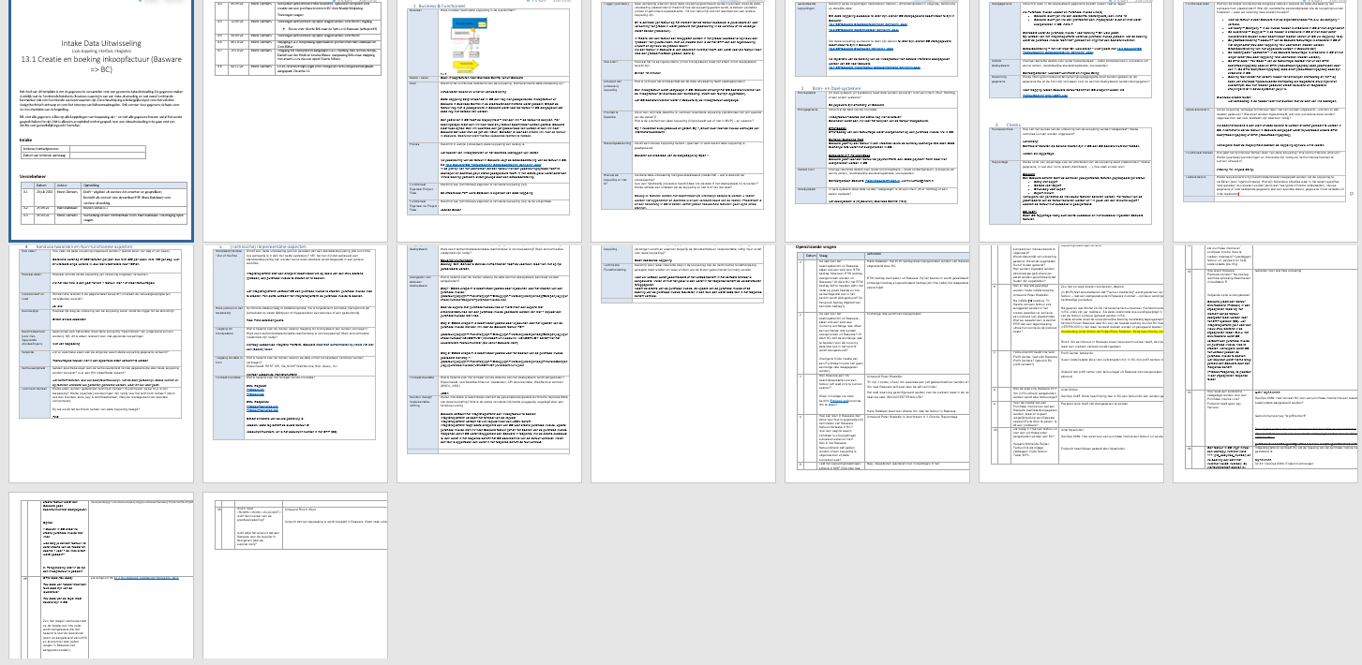


Application “Fingerprint”
Foundation for Solution Design and Test plan, basis for Operational mechanisms & processes
Describe for each Application:
business value and owner/stakeholders
priority / criticality
business process
trigger (when/why)
result (& verification)
source and destination systems
data structures & filtering | mapping
non happy flows
quality controls
security
operational targets

Slide 30
Dev => Ops
Certificate, credential, user, endpoints; Backup, Archive, Purge, Patching, Cost Allocation Support Desk
Dev
Deploy / Rollout / Activate
Intake / Ops Acceptance
Improve instrumentation, scalability, recovery, non happy flow handling, configurability
Observe
Interpret
Act
Learn & Improve
Routine Management
Fire drills / Chao(p)s Testing
Recovery, Fail Over, Hot Fix, Rollback of Rollout, Scale Out, …
Report & Improve
Ops

Slide 31

Intake: Check on Operability of Application
Dev
Intake / Ops Acceptance
Fingerprint
Definition of Success
QA-ed
Operability of Application
Photo by Priscilla Du Preez on Unsplash

Slide 32
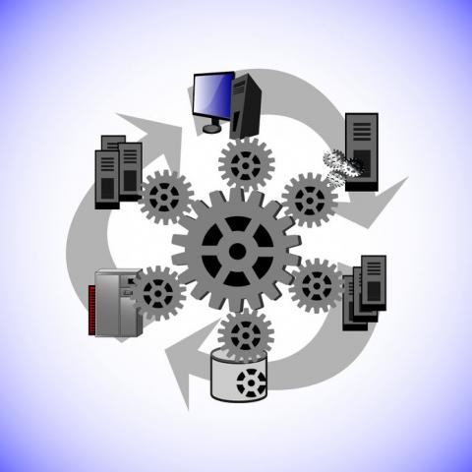
Ops Acceptance Test – confirm that operations can be done
Simulate realistic production runtime scenarios
Areas of interest:
detection | analysis | instruction | facilities | action | result
Notes:
Common scenarios:
Loss of network
Crash of server (container) (mid-job)
Peak traffic load
Incorrect message payload
Inaccessible endpoint
Invalid credentials
Power failure (forced restart)

Slide 33

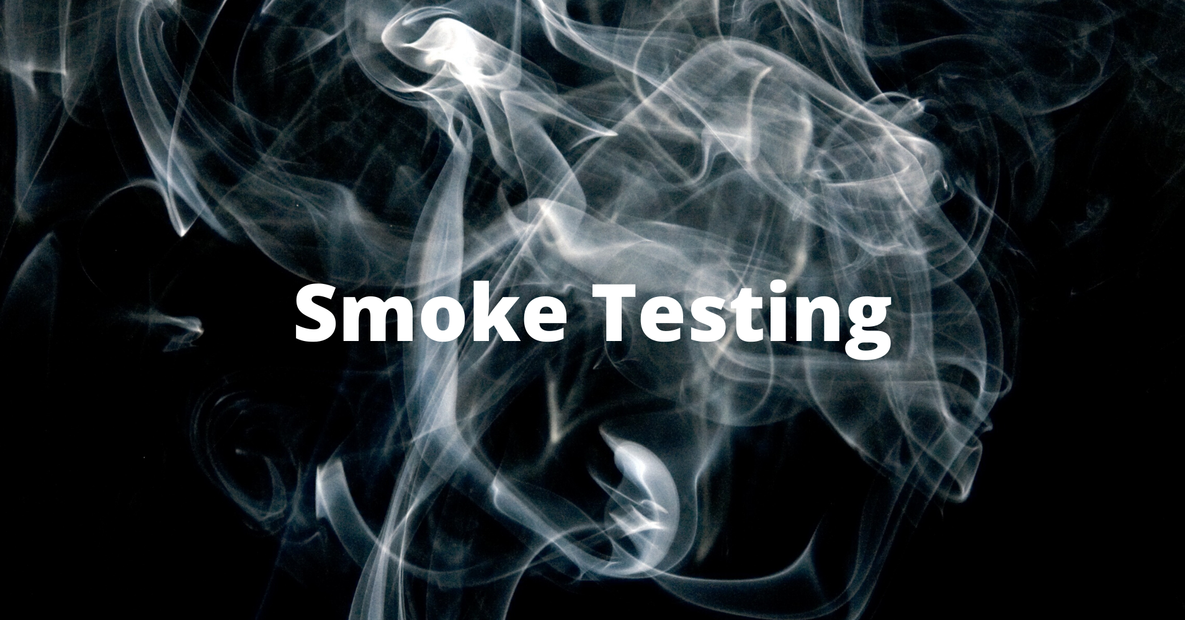
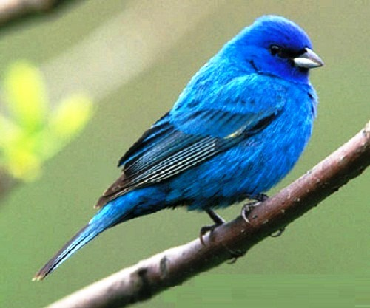

Deployment | Roll Out | Activation
Dev
Deploy / Rollout / Activate
Intake / Ops Acceptance
Automated
Configurable environment specific dependencies at Application, Platform & Infra
Verifiable through post-rollout Smoke Tests
Activate for subset of workload: Blue/Green, Canary
Scenario to Rollback

Slide 34




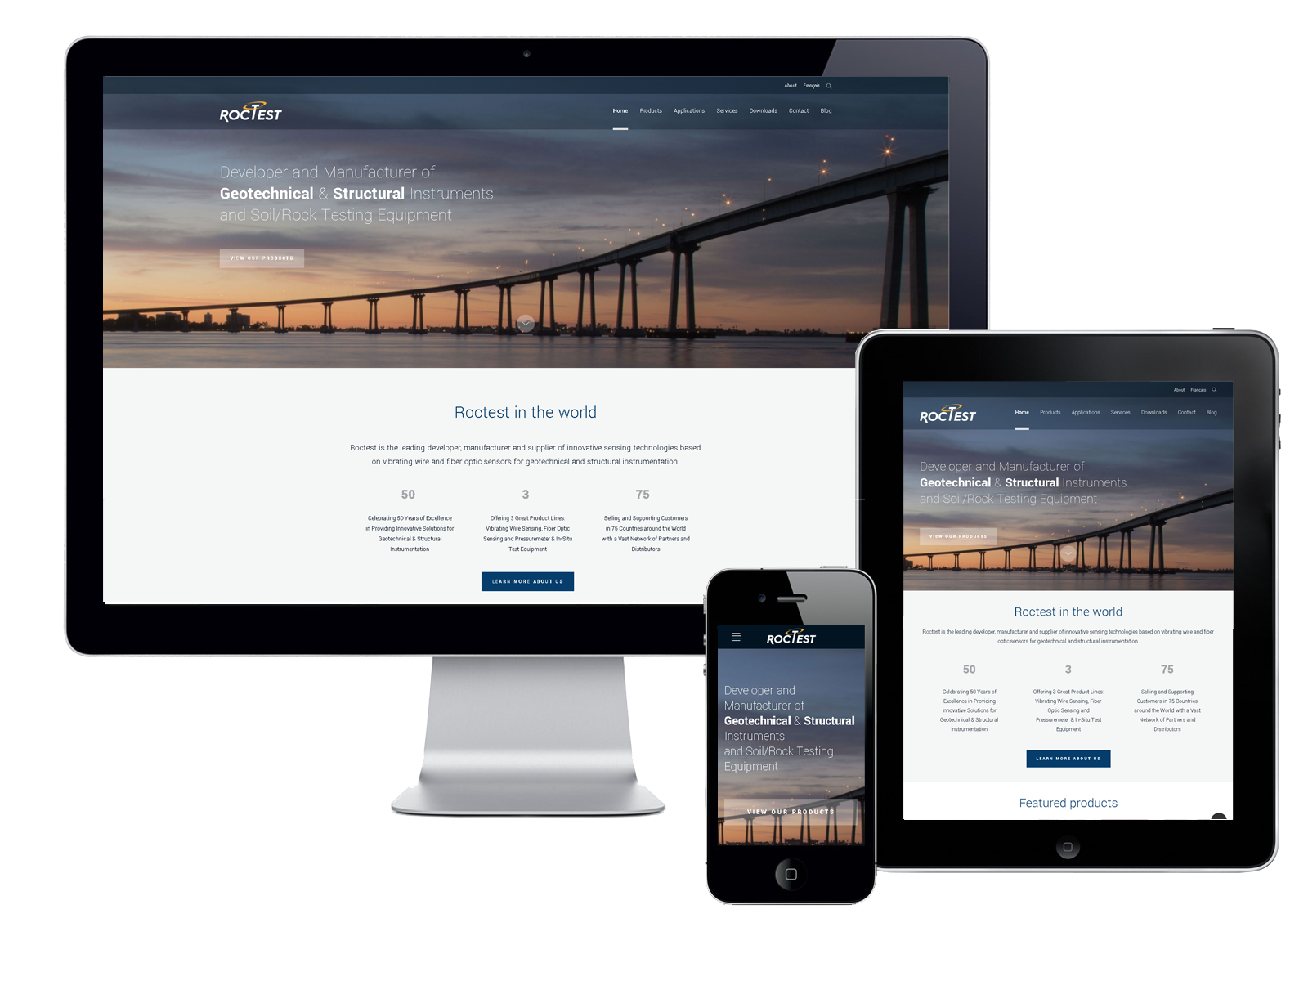
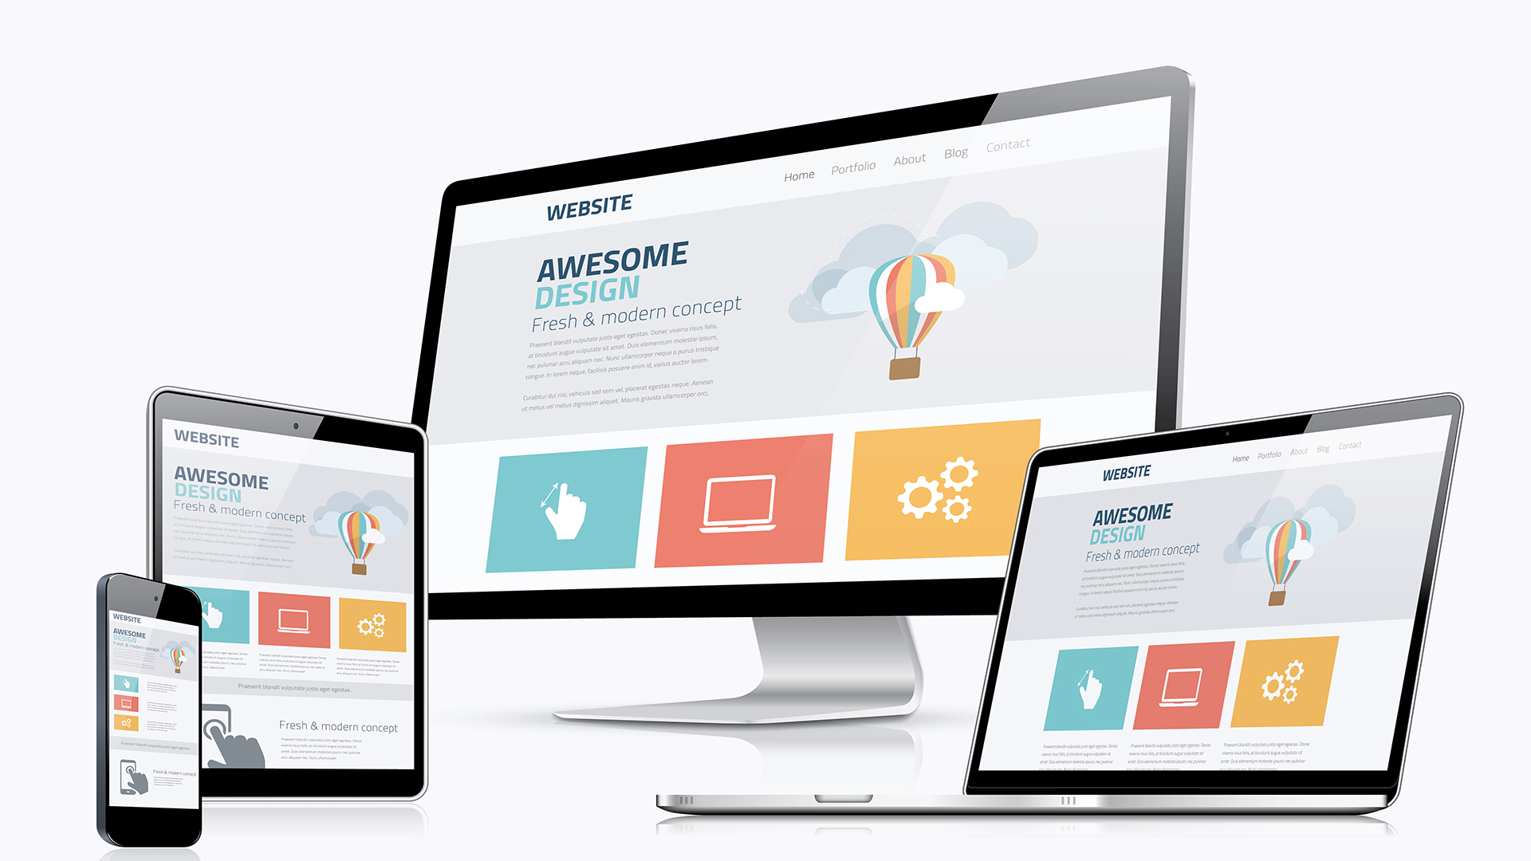
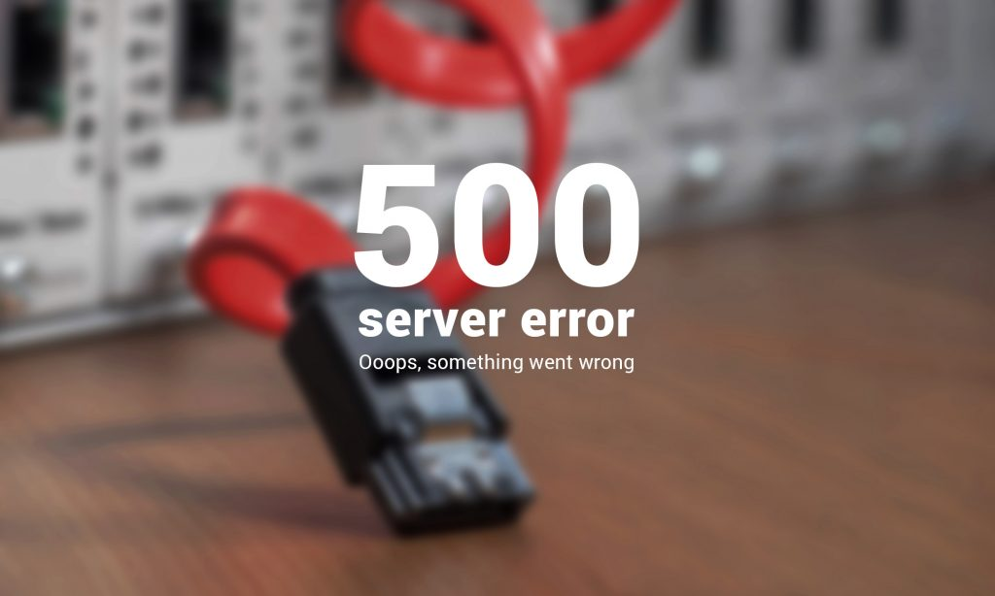

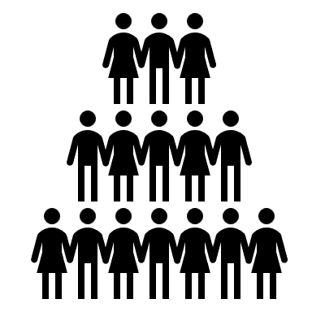
API

Slide 35
API
Catalog Service
Products Service
?
Products Service
Saturday Midnight
The loss of service was experienced on Monday morning

Slide 36

Beyond Smoke Test: Health Checks & In-Production Testing
Periodically check availability of owned and called endpoints
In Production Testing: dummy business objects “business side-effect free” but otherwise very real
No side effect – test all the way accessibility
API
ping
API
API
validate
create
Process business objects that are known to be dummies – not sent to external systems

Slide 37

Instrument & Emit - Observe – Interpret - Act
application
Visualize
application
Collect
process
& interpret
Act
telemetry
Alert
Platform & Infra
Report
Analyze
AIOps

Slide 38


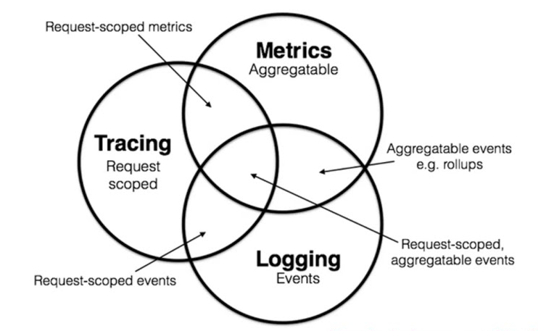
Telemetry – M(E)LT
The need to know
what happens
what is the status
Dimensions
real time and after-the-fact
fine grained and coarse grained
business & functional, security, cost, CO2 and technical
Types of Telemetry: MELT
Events, Profiles & Exceptions

Slide 39
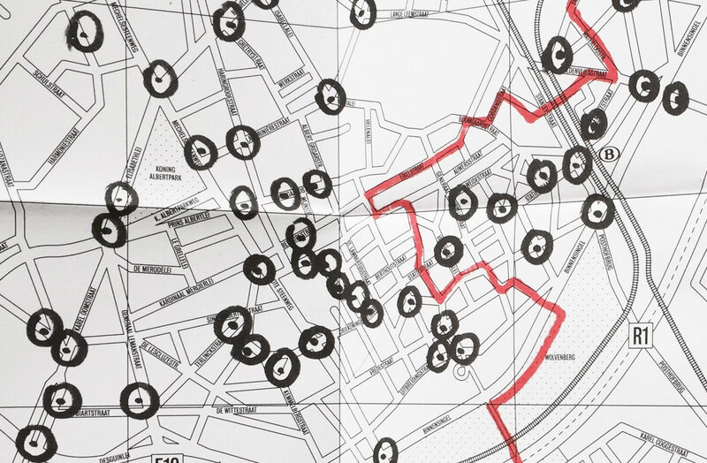
The Invisible Route
Notes:
https://www.google.com/url?sa=i&url=https%3A%2F%2Fwww.atlasobscura.com%2Farticles%2Fantwerp-invisible-route-map-surveillance-cameras&psig=AOvVaw1abfitkkT8VjPbxt27ywgm&ust=1669532135034000&source=images&cd=vfe&ved=0CBEQjhxqFwoTCLD4iICiy_sCFQAAAAAdAAAAABAE

Slide 40
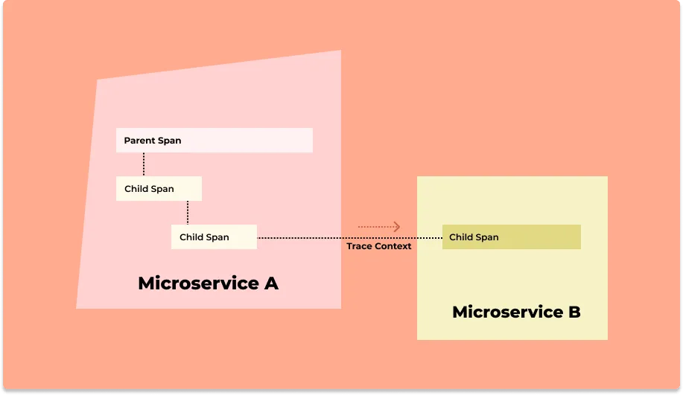
Tracing – end-to-end, cross hop visibility per request | transaction | process instance
Web Application
trace id, resource, begin & end timestamp, context, status
3rd party API
Trace
Parent Span
API Gateway
Trace Context
Child Span
Trace Context
Trace Context
API Gateway
Trace Context
Child Span
Child Span
Database

Slide 41
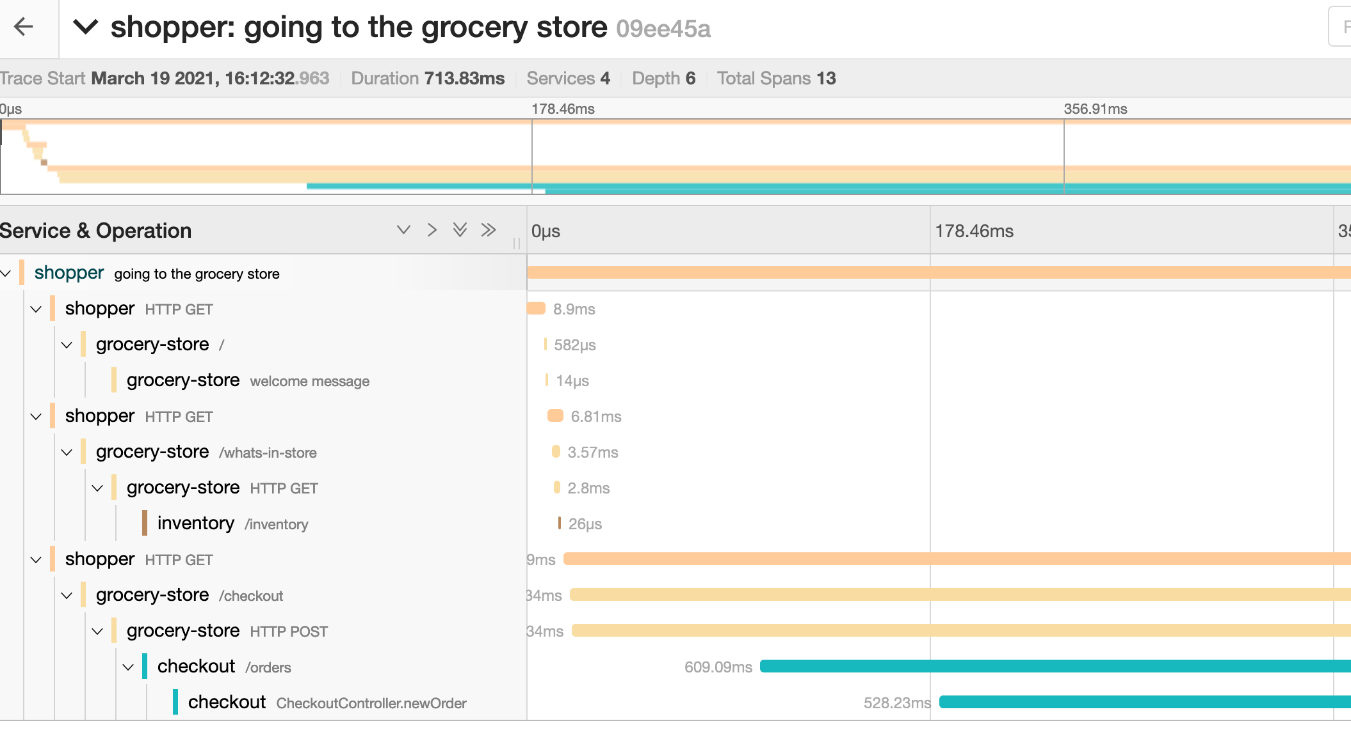
Tracing provides CCTV-like insight: when, where, what, why, who, how long
Track individual session | flow
Powerful aggregation across traces
group by component, status, origin, trace context attributes
Notes:
https://opentelemetry.io/docs/concepts/signals/traces/#span-links

Slide 42
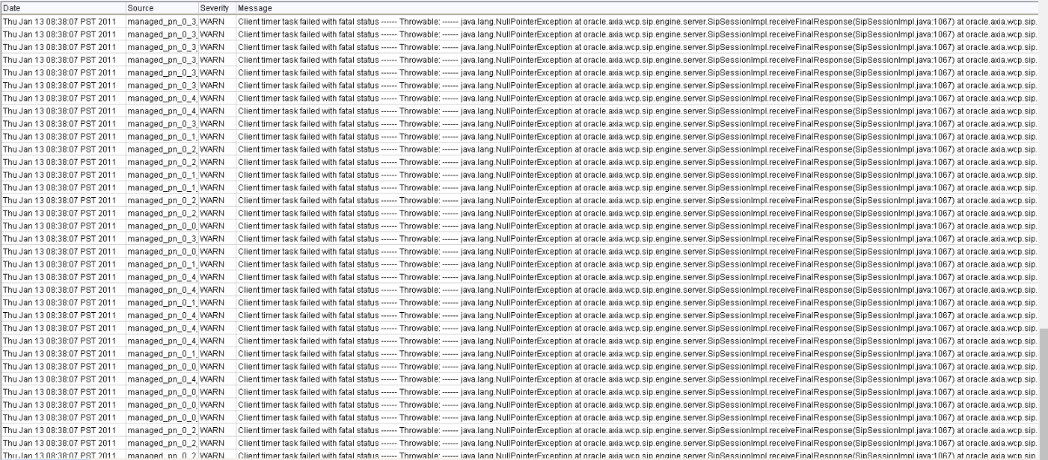
Logs – fine grained reports
Log event (typically when something happens):
logs can be associated with a job | request | transaction:
Logs provide drill down details for trace-span
Consolidated logs – from across application landscape – are powerful analysis tool
timestamp is crucial to sort and correlate
platform & infra
logs

Slide 43

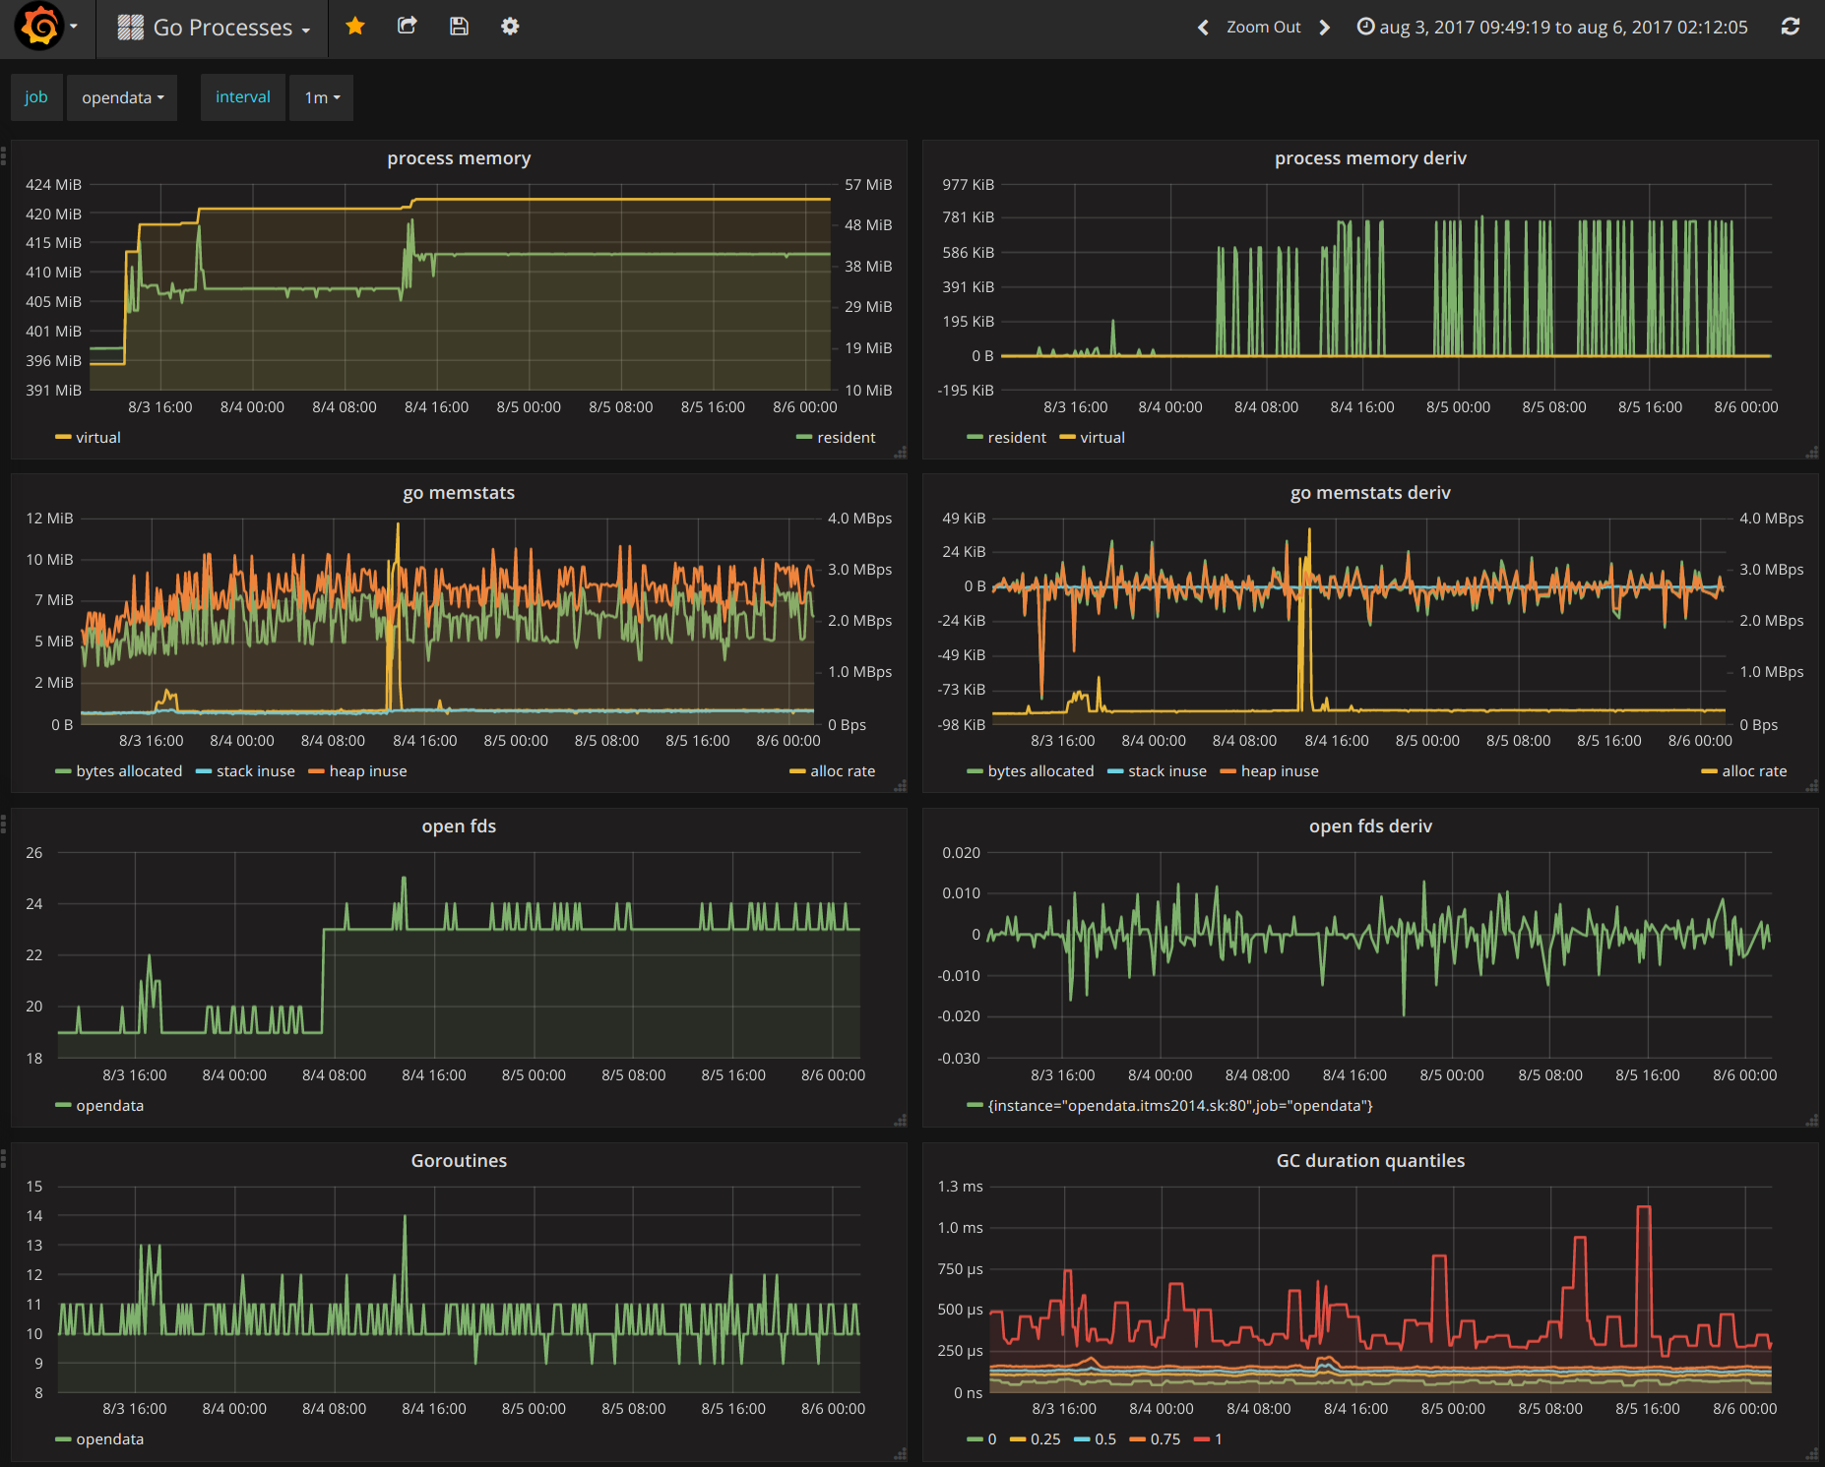
Metrics – periodic mini status reports
Timestamped measurements
Sometimes pushed, often polled/scraped
platform & infra
metrics

Slide 44

OpenTelemetry
Cross industry standard for collection of Telemetry
Virtually all tools for monitoring, analyzing, visualizing telemetry support OpenTelemetry as source

Slide 45

Events – telemetry context for analyzing and predicting
Black Friday
Horizontal Scale Out (double capacity for Service X)
Rollout/activation of new version of Service Y
Start of batch job Z
Snowstorm in the Köln area
Upgrade of Library P
New certificate for Component Q
Purged 2 TB of data from Time Series Database R
Outage in Azure Data Center (Frankfurt region)
Dortmund .. Bayern … Borussia .. nein, München meister
New engineer joined the DevOps team
Recovery test on database C
Ticket logged regarding poor performance
Expiry of Certificate K

Slide 46
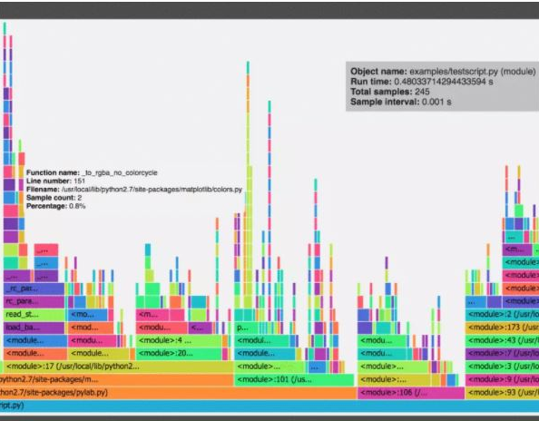
Profiling
Dynamic analysis at runtime
Periodic system snapshots (sampling)
Metrics
CPU & Memory usage per process & child process | thread
Application Call tree
Duration & frequency of function calls
Detailed bottleneck analysis

Slide 47

Collect, Correlate, Interpret, Alert
Create the overall picture
Detect
Find what’s mssng – unexpected unevents
Automate

Slide 48




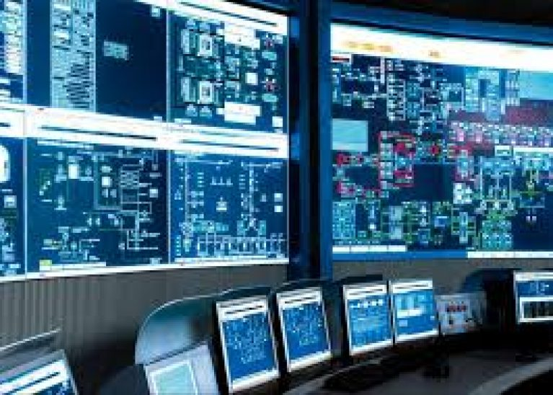
Ops Obs is a veritable BI challenge
Instrumentation & Configuration determines telemetry
Traces, Log entries, Metrics, Context Events
Service
API
WebApp
Telemetry Lake
Function
Integration
Job
platform
infra

Slide 49
The Ideal Dashboard …

Slide 50

The Ideal Dashboard …
Dashboard
Now
Past & Future

Slide 51

The Ideal Dashboard …
Dashboard - Now
Now
Past & Future
Alerts Notifications Actions
drill
down
Heartbeat – Proof of Health

Slide 52
The Ideal Dashboard …
Dashboard – Past & Future
Now
Past & Future
Trend & Pattern Charts Predictions Simulations / What-If explorations

Slide 53
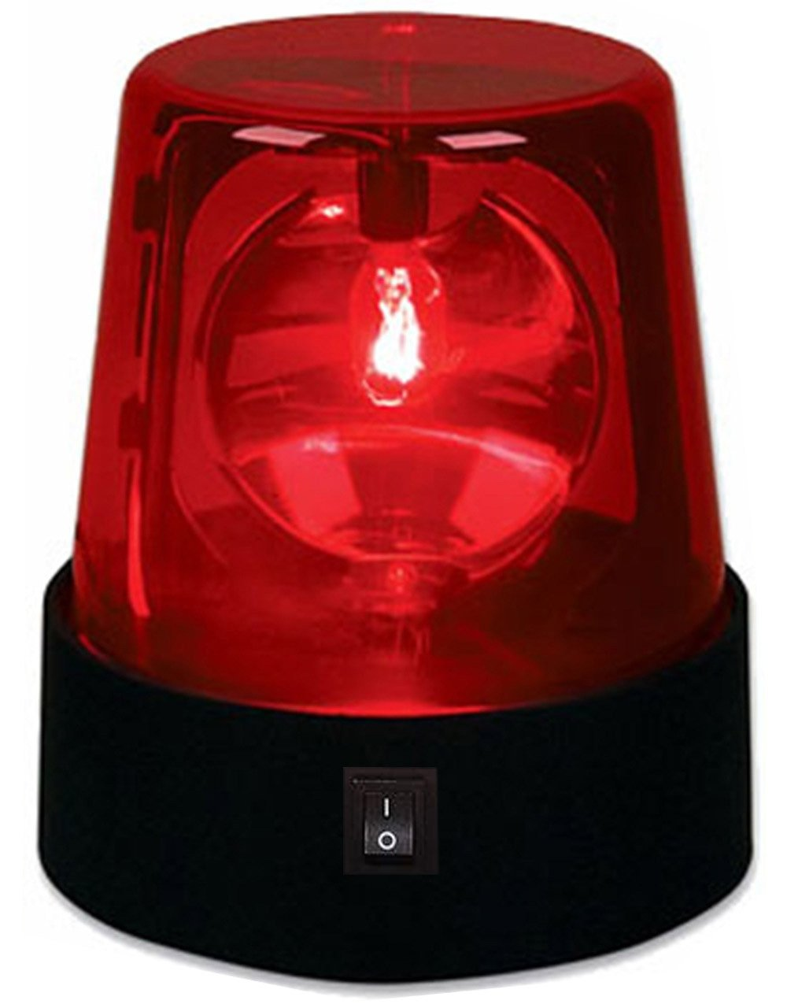
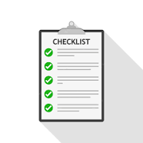

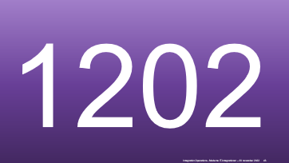
Act upon Alert
?
Need to know what to do when and how to do it then
how important is it? what is priority?

Slide 54
1202
Notes:
https://www.slideserve.com/ayala/se-3910-real-time-systems

Slide 55
1202

Slide 56
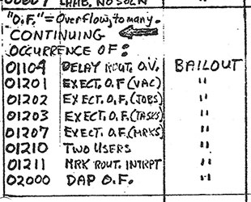




1202

Slide 57
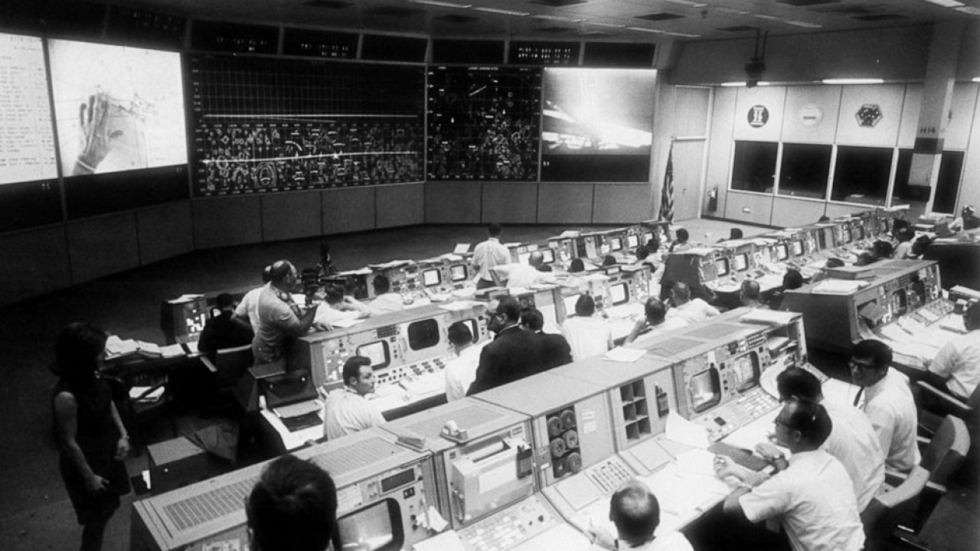
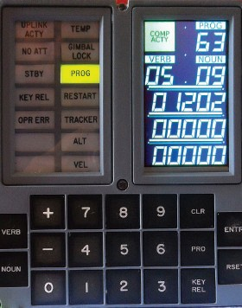


Slide 58
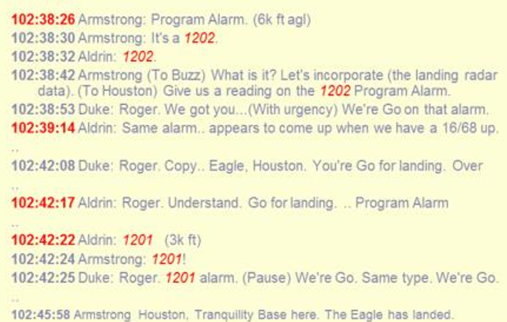
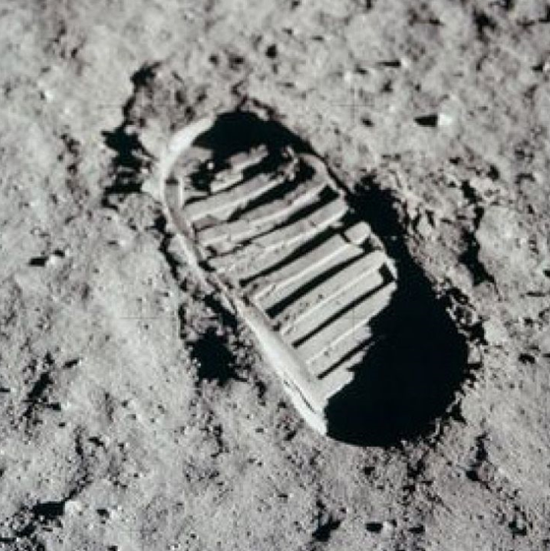
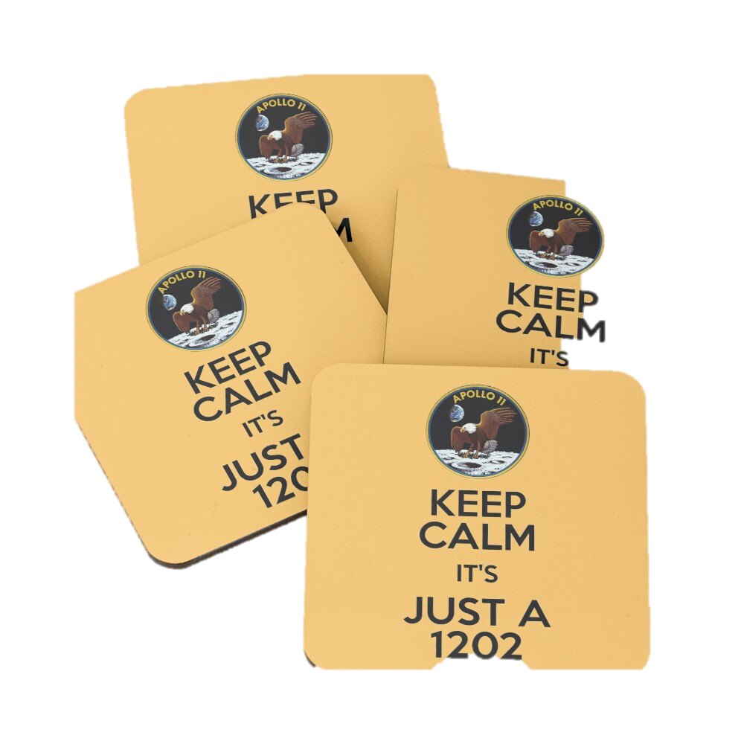
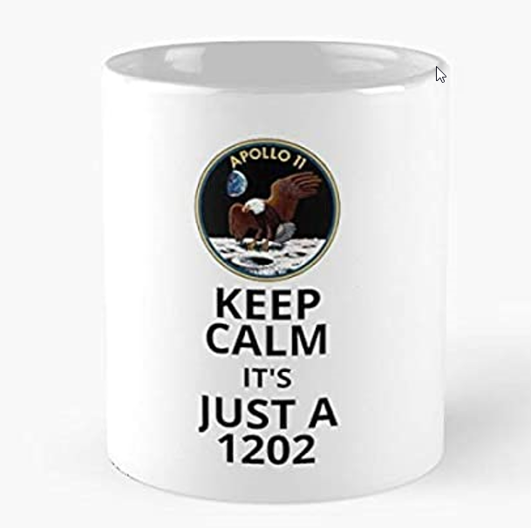



Slide 59
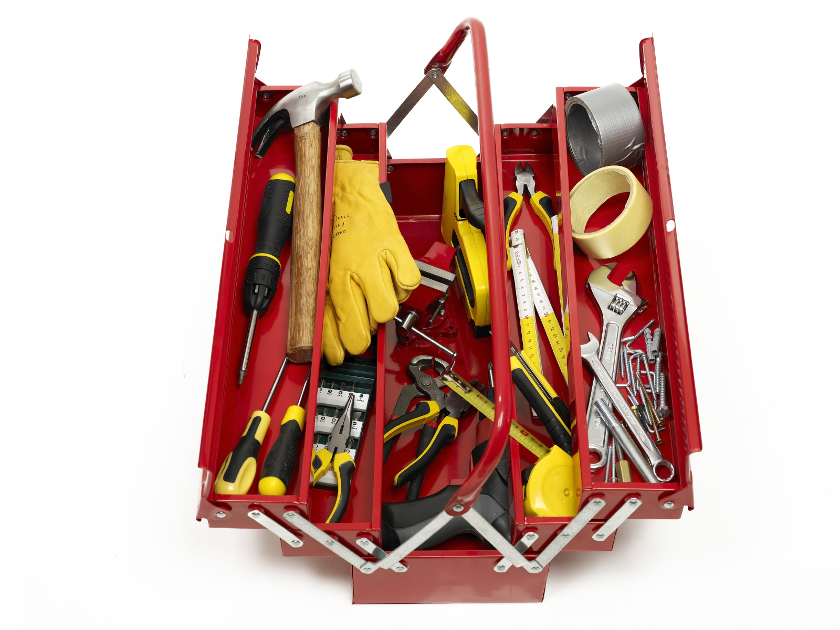
Means & Mandate to act – Application & Platform/Infra
Inspect
Reconfigure
Scale
Restart
Resubmit
Apply Patch
(Re)schedule job
Perform recovery
Provision & Update Infra
Acquire (temporary) elevated privileges
Observe
Interpret
Act
Learn & Improve
Routine Management
Fire drills / Chao(p)s Testing
Report & Improve
Notes:
expired certificate
Product Owner cannot be reached
Wiki is down
Storage inaccessible
Critical vulnerability in library
DDOS attack detected
Ransomware alert
Data Corruption (human error)
failing DNS server
Azure availability zone is down
team tech lead falls ill
P1 bug in recent production release
Edge connectivity lost
Power outage

Slide 60
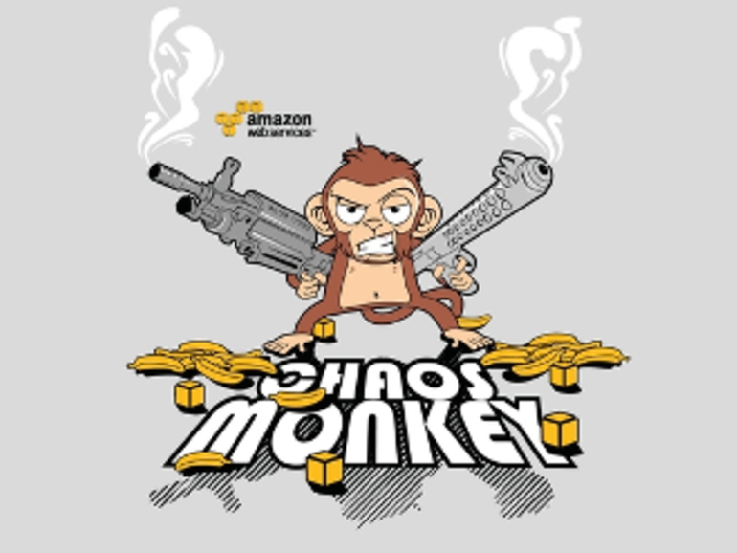
Operations Firedrills
Testing Resilience of
systems & automated procedures
processes
people
Azure availability zone is down
Ransomware alert
Storage inaccessible
Data Corruption (human error)
expired certificate
team tech lead falls ill
Edge connectivity lost
Critical vulnerability in library
failing DNS server
Product Owner cannot be reached
P1 bug in recent production release
Power outage
DDOS attack detected
Wiki is down
Notes:
expired certificate
Product Owner cannot be reached
Wiki is down
Storage inaccessible
Critical vulnerability in library
DDOS attack detected
Ransomware alert
Data Corruption (human error)
failing DNS server
Azure availability zone is down
team tech lead falls ill
P1 bug in recent production release
Edge connectivity lost
Power outage

Slide 61

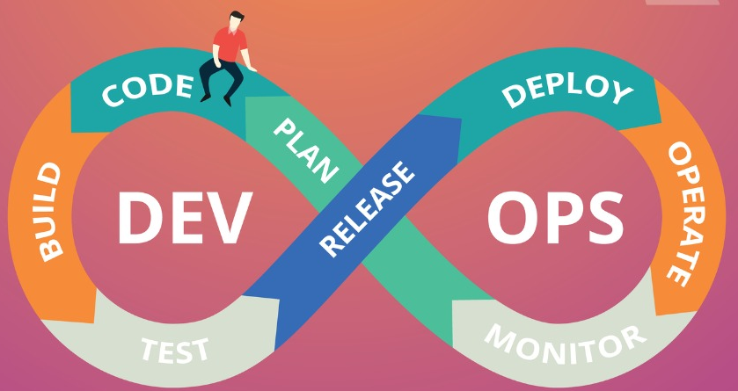
Improvements over time
Observe and extrapolate
Explore What-If scenarios
Automate
Calibrate
Refine schedules
Fine-tune Tools and Procedures
Extend configurability
Automate (AI), dynamic, predictive configuration
Refine instrumentation
Improve telemetry processing
Decommission

Slide 62
Summary
Operations for successful business functionality
Define success
Design & Build Observability & Operability
Test Operations
Shift Left – “Ops by Design”
Not DevOops but DevOps
Development
DevOps
Operations
Application
Platform

Slide 63
Thank you for your attention I hope this was useful
lucas.jellema@conclusion.nl | technology.amis.nl | @lucasjellema | lucas-jellema

